Slide 1
How Insightful!
Grok Your ASP.NET Core Web Apps with Application Insights

Slide 2


Hi! I’m Cam. I work for Microsoft.

Slide 3
What we’ll cover
What Application Insights is and why you need it
Instrumenting your app for Application Insights
Viewing Application Insights telemetry
Using telemetry in our ASP.NET Core app to solve:
A performance bottleneck
An unhandled exception

Slide 4
Why you need Application Insights
(Unless you don’t want to know what your application is doing)

Slide 5


Production troubleshooting

Slide 6
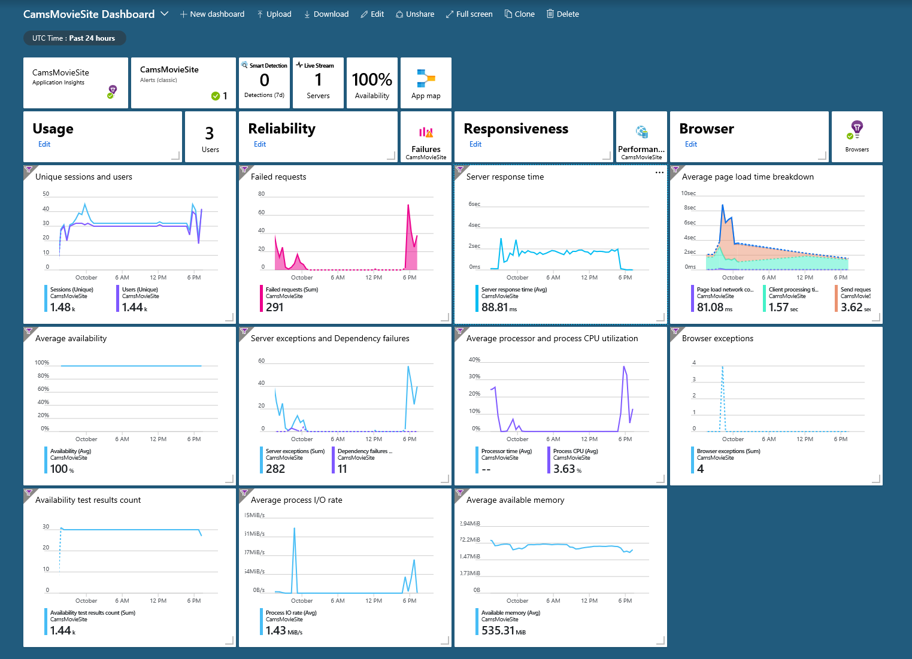
Insights at a glance

Slide 7
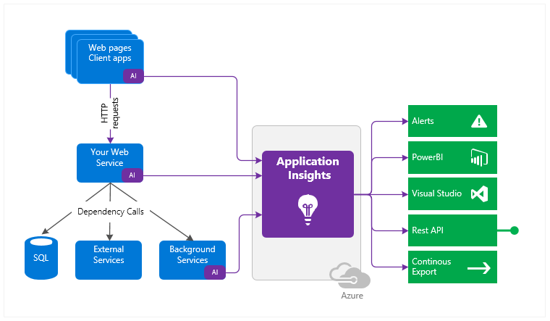
Where did you come from, where did you go?

Slide 8
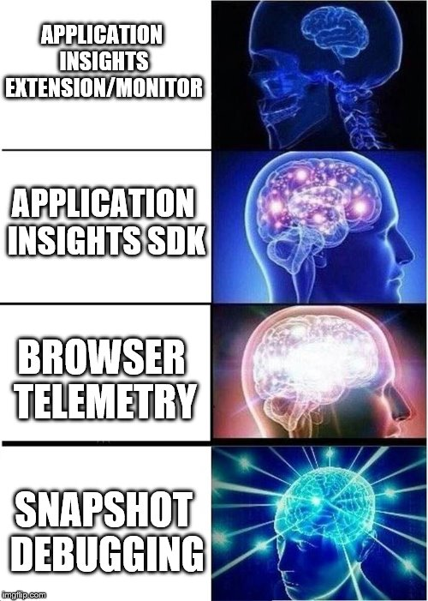
Instrumentation escalation

Slide 9

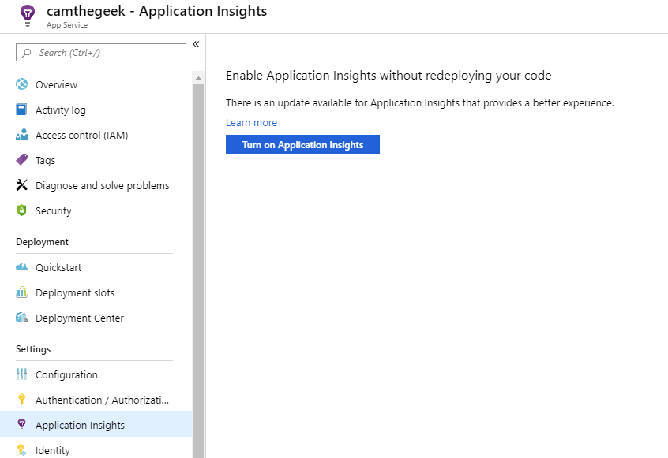



Enabling build time telemetry in Azure

Slide 10
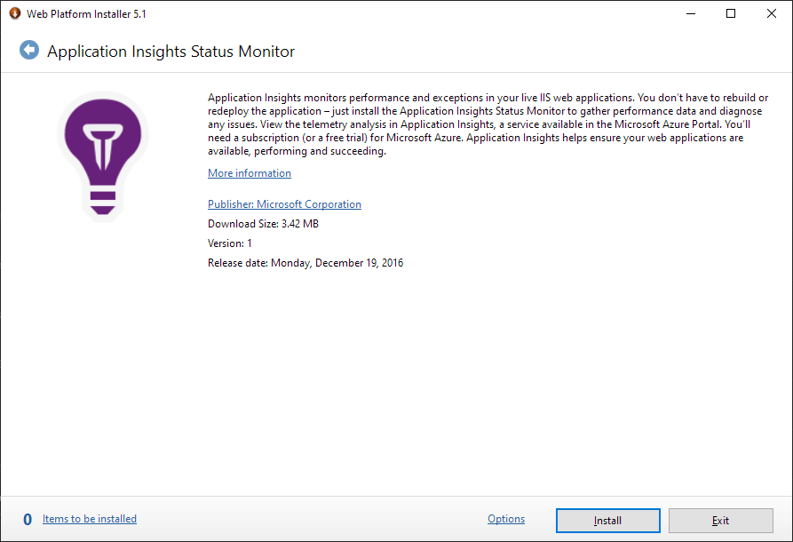
Enabling build time telemetry in IIS

Slide 11
Demo – Runtime Instrumentation and Telemetry
Get to the good part already!

Slide 12
Conclusion
We’re almost done!

Slide 13
What’s next?
https://github.com/camsoper/how-insightful
Things to check out next
Profiling
Analytics (machine learning)
Alerts
Workbooks/Reports
API/Continuous Export
Excellent docs! https://docs.microsoft.com/azure/azure-monitor

Slide 14


Thank you! @CamSoper CamSoper

